Slide 1
easy-test
杨华伟

Slide 2
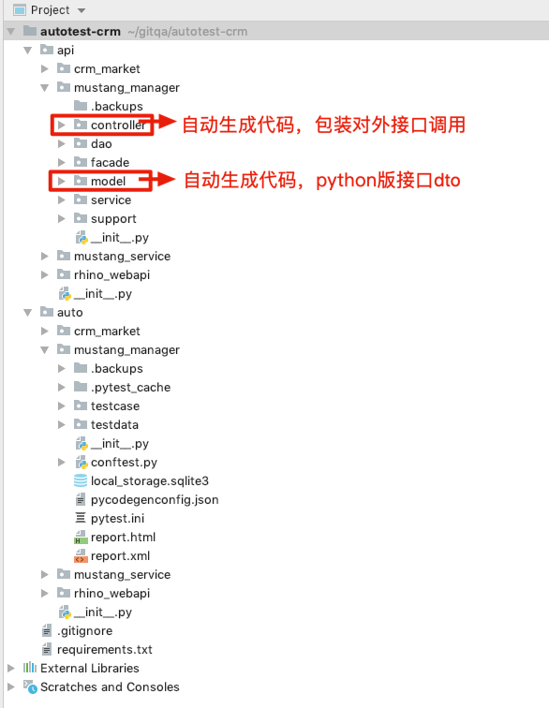
项目结构

Slide 3
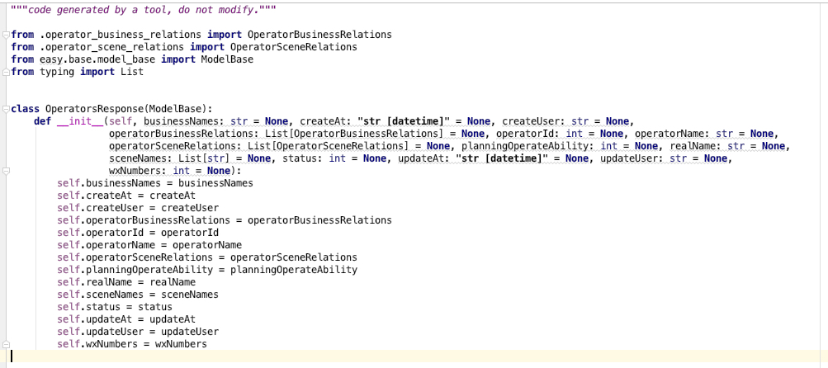
Model with type annotation

Slide 4
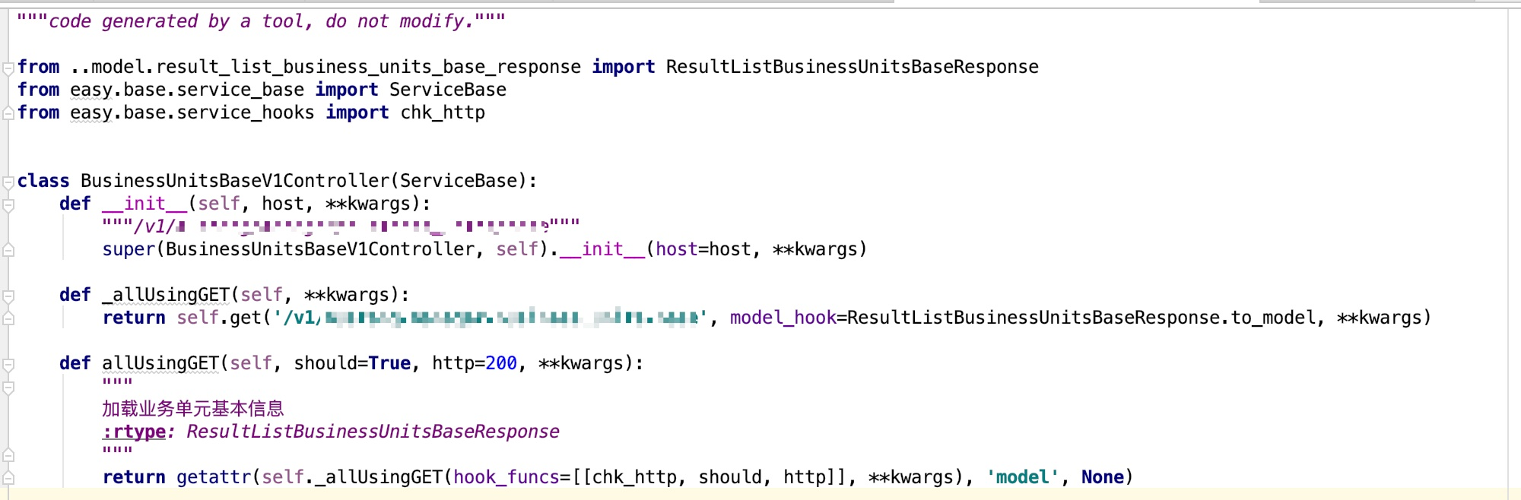
Controller with default hooks

Slide 5
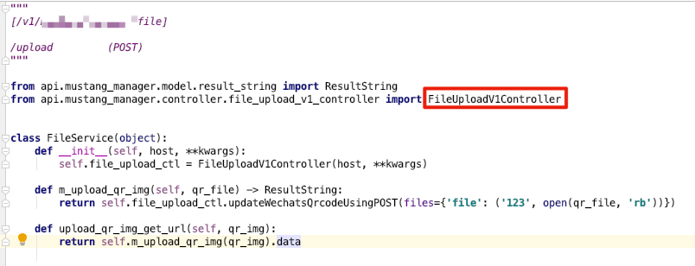
Service as an service to serve testcases
需要封装、扩展、组合？
Use service

Slide 6
conftest.py – the simple plugins
替代xunit风格，setup/teardown…
Scope: session, package, module, class, function
Location: root conftest, sub directory conftest, module/class conftest

Slide 7
Testcase
Principe 1
Arrange
Act
Assert
Principe 2
Work with service not with controller

Slide 8
testcase with pytest
Mark
fixture
Report（pytest-html)

Slide 9
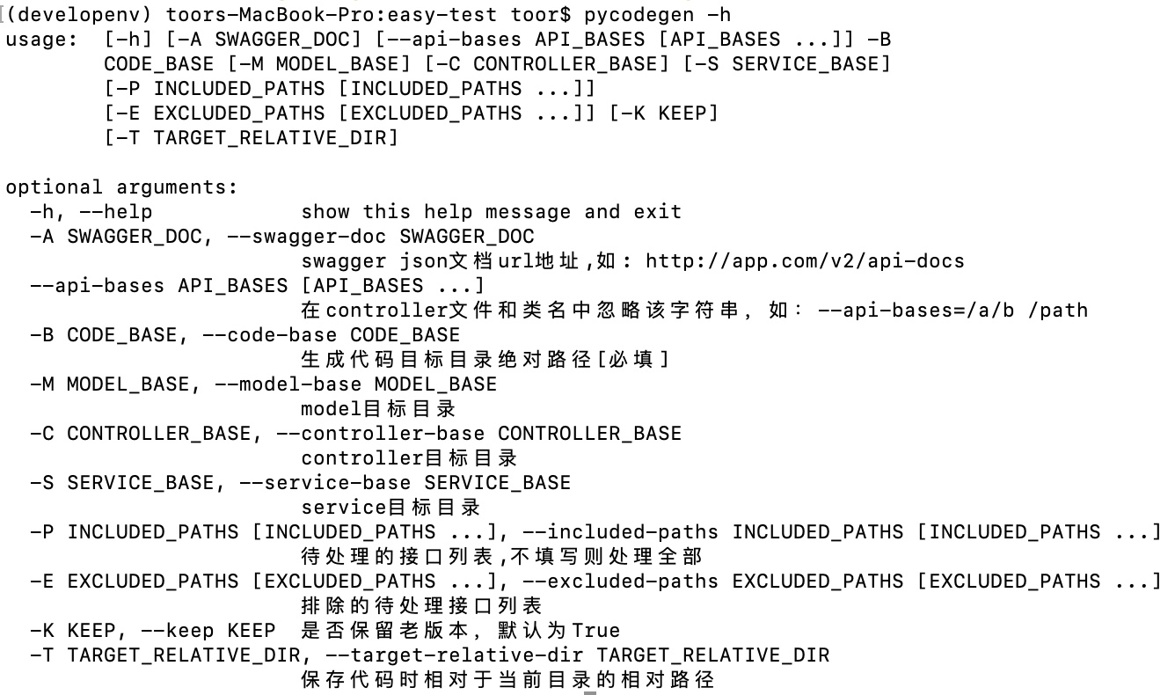
pycodegen

Slide 10
pycodegenconfig.json
{ "swagger_doc": "http://localhost:9222/v2/api-docs", "api_bases": [ "/mustang/manager" ], "included_paths": [], "excluded_paths": [], "target_relative_dir": "../../api/mustang_manager" }
位置：测试项目根目录，auto/mustang_manager/pycodegenconfig.json

Slide 11
DB访问
对MySQL，SQLServer，Sqlite的增删改查
ORM OR NOT
Database factory

Slide 12
Util
dateUtil
jsonUtil
local_storage
netUtil
randomUtil

Slide 13
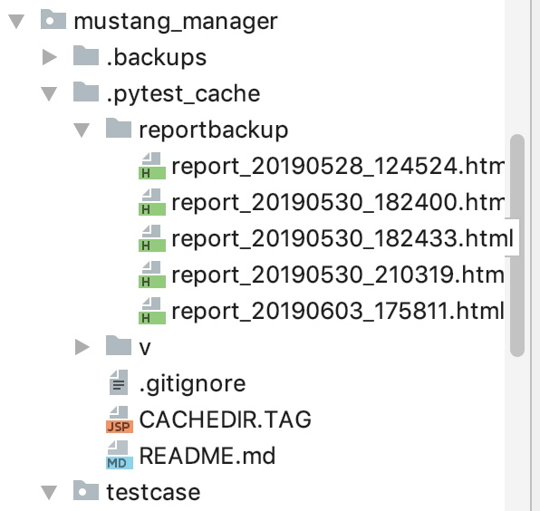
pytest_salt
指定执行环境 –env qa,qa1,qa2…
Auto backup reports

Slide 14
KEY WORDS
TestData
Testcase
conftest
Utilities
Service
Plugins
Controller
Model

